Slide 1


Group Benefits
for participating members

Slide 2

Unistar Special Risks Inc.
At Unistar, we have 80+ years of benefit experience from service to sales to underwriting and we have underwriting authority backed by one of the Worlds largest Reinsurers. www.unistarinc.ca
We are consistently evolving to find solutions for risks in new markets. Offering benefits at accessible, affordable, and renewable rates, at Unistar we believe that there should be a rate for every risk.
As a dynamic, creative insurance wholesaler, we can identify these opportunities, develop products because of our access to specialty markets, and we distribute these products through our qualified, independent Third-Party Administrator.
We are a proud member of CAMGA.

Slide 3

What is CAMGA Group Benefits?
A CAMGA branded group benefits plan, regardless of group size with many options focusing on services, costs and values rather than the insurers.
The intent is to create a block of business for CAMGA members in order to take advantage of a single renewal date, blended block rates and lowered plan expenses.
Specializing in underwriting Associations, Unistar has created a program for CAMGA members allowing for corresponding buying power.

Slide 4
OBJECTIVES OF CAMGA Benefits?
Stage 1: Initial enrollment period for all interested members creating a fully insured Association block program for the first two years of operations.
Stage 2: Creation of a “captive” style arrangement where the block is self-insured with appropriate stop loss. The result of this is to bring the absolute lowest cost to the members even those too small to be considered for self-insurance on their own. This will create a unique offering not available to many members and will be examined at the end of year two.
Stage 3: At the end of year two, consider expanding the plan to brokers who use the CAMGA member services, allowing them to join the plan for their own employees.

Slide 5



CAMGA
Pooled Benefits,
EHC and Dental Block
The intent is to create a block of business for CAMGA members in order to take advantage of a single renewal date, blended block rates and lowered plan expenses.
Much lower admin and claim charges to smaller clients due to combining risks and no IBNR’s Reserve Account.
A competitive Target loss ratio (TLR) which includes claims, admin fees, taxes and Broker commission.
As a TPA is required, we have a set per employee cost that is maintained outside of the plan expenses and therefore not affecting the TLR.

Slide 6

CAMGA features
No family content rules
No IBNR’s
(Incurred but not reported reserves)
Option of LTD to age 70
Third Party Administration (TPA) Services using state of the art systems not tied to an insurer

Slide 7

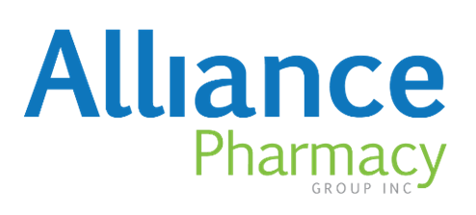

CAMGA Value Added Services
Employee Assistance Programs
  Telephonic and Full Service
Medical second opinion product
Eldercare
www.humanacare.com
Extra Optional Benefits for employees www.choicesforme.ca
Direct to your door prescriptions www.alliancepharmacygroup.ca

Slide 8

HOW TO QUOTE
Current Benefit Summary and/or Employee Booklet
Employee Data Sheet in Excel
Renewal Reports – 2 years
Rates and Claims Experience – 2 years
Deviations from current plan design if changes are desired.
Reach Out to Us at 403.297.0252 or at underwriting@unistarinc.ca

Slide 9

CONCLUSION
through Unistar Special Risks Inc. are pleased to provide these Benefits to the CAMGA members.
In order to access the plan please contact:
If you are the acting broker for a CAMGA member please advise Unistar at the time of quote request and CAMGA at https://camga.ca/contact-us-nous-joinder/

